Slide 1

Welcome to
Presentation Editor

Slide 2
Use HTML5 Online Editor
Create, edit and share presentations right on your TeamLab portal
Use all the wealth of editing tools like in a desktop editor
Demonstrate your colorful work to your colleagues or business partners

Slide 3
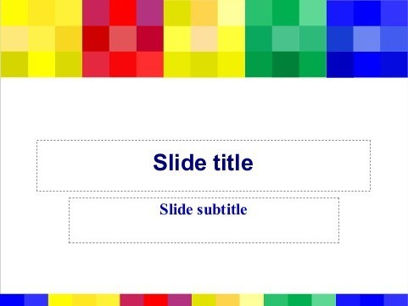

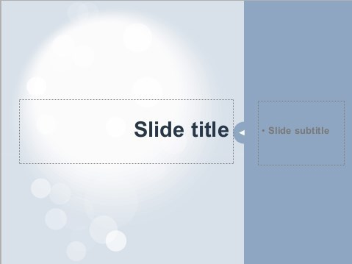



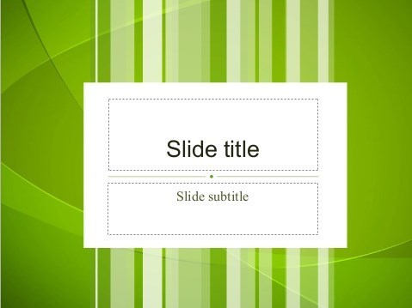
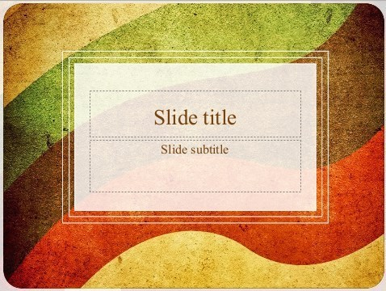



Select and adjust a theme

Slide 4
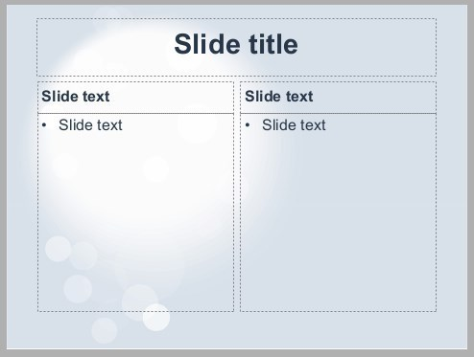
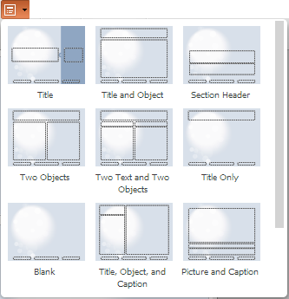
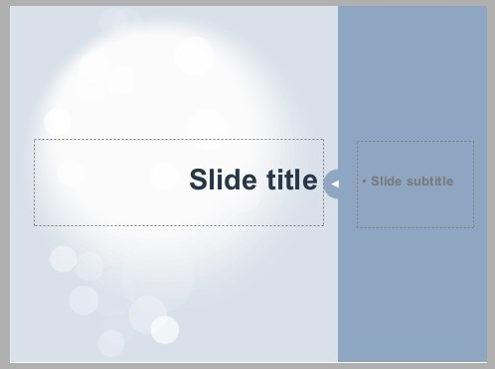
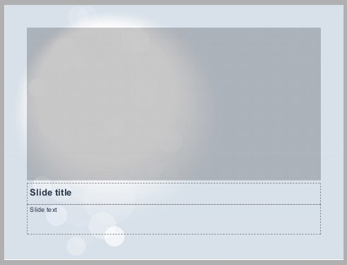
Apply the required page layout

Slide 5

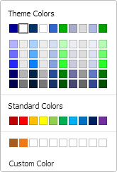
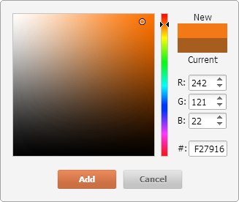
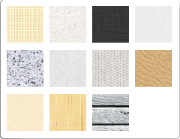
Use color, image, texture fills
Select colors from the available palettes
Specify custom colors
Use textures as a slide background
Or choose any picture for this purpose

Slide 6


Add, modify, arrange autoshapes
You can use an image or a texture to fill the shape with
Align shapes and set their order to gain the desired effect

Slide 7

Use images to illustrate your ideas
and make your presentation more expressive

Slide 8
Format your text as you need
The main features:
The main benefits:
Add bulleted and numbered lists
Set line spacing
Increase or decrease indents
Align your text within the text box
Select the font type, size, color
Apply font decoration styles
The rich choiсe of text formatting tools helps you to expound your theses clearly
Your text formatting emphasize your thoughts
The form of expression of your ideas is no more limited

Slide 9
Save,
Print,
Share,
Download
your
work
Save the created presentation on your portal
Share it with other portal users or make it public
To work on your presentation collaboratively, specify who can view or edit it
Print or download the presentation as a .pptx or .pdf file

Slide 10

Create your own presentation with

